Slide 1
Practical Lab
By Jeremy Lim

Slide 2
If you’re seeing this from the email, sorry I can’t share code ☹

Slide 3
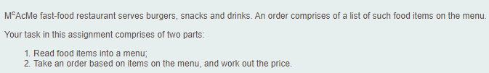

Step by Step

Slide 4
Step by Step
id
name
price
Food
Burger
Snack
Drink
(okay to consider drinks as food)
This is all you need for level 1

Slide 5

Step by Step
(Lists)
snacks
burgers
drinks
Menu
add(Burger), add(Snack), add(Drink)
id
name
price
Food
Burger
Snack
Drink
(okay to consider drinks as food)

Slide 6


Step by Step
(Lists)
snacks
allFood
burgers
drinks
Menu
add(Burger), add(Snack), add(Drink)
find(int id)
id
name
price
hasId(int)
Food
How to find food efficiently?
Naïve solution: Check all 3 lists
SMART solution: Store a List<Food>
Burger
Snack
Drink
(okay to consider drinks as food)

Slide 7
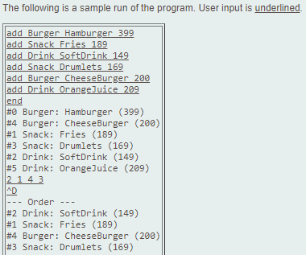
Step by Step
(Lists)
snacks
allFood
burgers
drinks
Menu
add(Burger), add(Snack), add(Drink)
find(int id)
id
name
price
hasId(int)
Food
Burger
Snack
Drink
(okay to consider drinks as food)
Doesn’t look like you need an Order class up to here

Slide 8
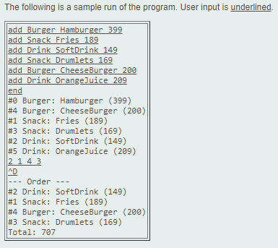
Step by Step
(Lists)
snacks
allFood
burgers
drinks
Menu
add(Burger), add(Snack), add(Drink)
find(int id)
id
name
price
hasId(int)
Food
Burger
Snack
Drink
(okay to consider drinks as food)
items
But when you consider the Total line…
Order
add(int id)

Slide 9
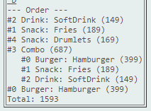
Step by Step
(Lists)
snacks
allFood
burgers
drinks
Menu
add(Burger), add(Snack), add(Drink), add(Combo)
find(int id)
id
name
price
hasId(int)
Food
Burger
Snack
Drink
Combo is obviously a Food
Food might not be as good a name as “Item” but it’s fine for now, change later if have time (No big deal)
(okay to consider drinks as food)
items
burger, snack, drink
Order
Combo
add(int id)
Combo(menu, burgerId, snackId, drinkId)

Slide 10
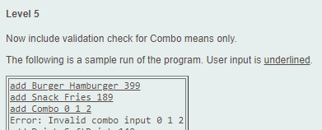
Step by Step
(Lists)
snacks
allFood
burgers
drinks
Menu
add(Burger), add(Snack), add(Drink), add(Combo)
find(int id)
How? Validate and throw exception Can’t cast in Combo constructor: ClassCastException Item not found in menu: NoSuchElementException
id
name
price
hasId(int)
Food
Burger
Snack
Drink
(okay to consider drinks as food)
items
burger, snack, drink
Order
Combo
add(int id)
Combo(menu, burgerId, snackId, drinkId)

Slide 11
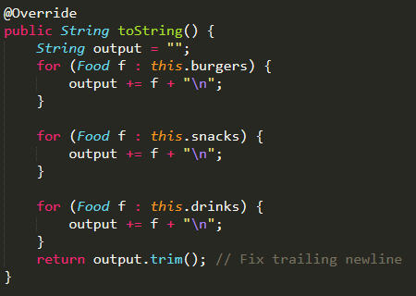
Improvements
(Lists)
snacks
allFood
burgers
drinks
Menu.java
Menu
add(Burger), add(Snack), add(Drink), add(Combo)
find(int id)
id
name
price
hasId(int)
Food
Burger
Snack
Drink
(okay to consider drinks as food)
items
burger, snack, drink
Order
Combo
add(int id)
Combo(menu, burgerId, snackId, drinkId)

Slide 12
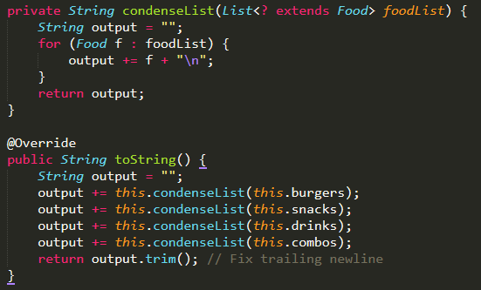
Improvements
(Lists)
snacks
allFood
burgers
drinks
Menu.java
Menu
add(Burger), add(Snack), add(Drink), add(Combo)
find(int id)
id
name
price
hasId(int)
Food
Burger
Snack
Drink
(okay to consider drinks as food)
Level 6 done with 1 additional line
items
burger, snack, drink
Order
Combo
add(int id)
Combo(menu, burgerId, snackId, drinkId)

Slide 13
Key Takeaways
Design before coding – draw diagrams to help
Use OOP where it makes sense, even if you may not need it yet

